Slide 1


Slide 2
PROJECT PRESENTATION ON PREDICTION OF DIABETES
PRESENTED BY
SAI THARUN REDDY A

Slide 3
TABLE OF CONTENTS
ROLE OF DATA SCIENCE IN DISEASE (INTODUCTION)
SETPS INVOLVED IN THE DEVELOPMENT OF THE MODEL
DIGITAL MATERIALS UTILISED
PREDECTION ALGORITHMS USED
KNEIGHBOUR CLASSIFIER
SIMPLE VECTOR MACHINE CLASSIFIER
GAUSSIAN NAIVE BAYES CLASSIFIER
CONCLUSION

Slide 4
ROLE OF DATA SCIENCE IN DISEASE DETECTION
Diabetes has become one of the major causes of national disease and death in most countries.
According to the International Diabetes Federation report, the figure is expected to rise to more than 642 million in 2040, so early screening and diagnosis of diabetes patients have great significance in detecting and treating diabetes on time.
Diabetes is a multifactorial metabolic disease, its diagnostic criteria is difficult to cover all the ethnology, damage degree, pathogenesis and other factors, so there is a situation for uncertainty and imprecision under various aspects of medical diagnosis process.
With the development of Data mining, researchers find that machine learning is playing an increasingly important role in diabetes research.
Machine learning techniques can find the risky factors of diabetes and reasonable threshold of physiological parameters to unearth hidden knowledge from a huge amount of diabetes-related data, which has a very important significance for diagnosis and treatment of diabetes.
So this project provides a survey of machine learning techniques that has been applied to diabetes data screening and diagnosis of the disease.
In this project, conventional machine learning techniques are described in early screening and diagnosis of diabetes.
More over deep learning techniques which have a significance of biomedical effect are also described.

Slide 5
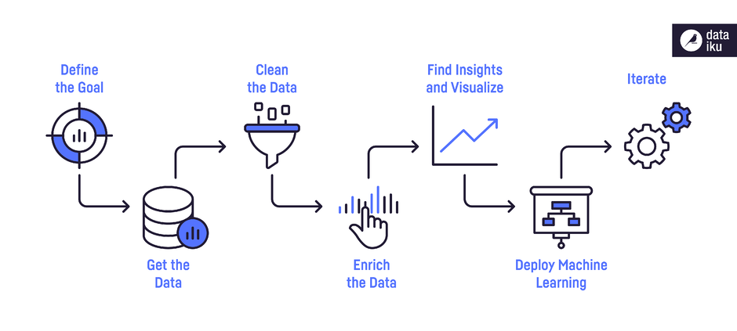
Steps involved in developing the model

Slide 6
Digital Materials utilised
SOFTWARE’S:
Anaconda navigator's Jupiter notebook
WEBSITES:
Kraggle for obtaining the dataset Pima Indians Diabetes Database.
LIBRARIES:
Pandas,
Numpy,
Matplotlib,
Seaborn,
Scikit Learn

Slide 7
PREDICTION ALGORITHMS USED
KNeighbour Classifier,
Simple Vector Machine Classifier,
Gaussian Naive Bayes(GassianNb).

Slide 8
Kneighbour Classifier
Methodology:
First we fit the train sets into the model and then input the test set into the trained model to obtain the required results.
Results of using this classifiers are:
Total number of correct predictions i.e., predicted and real outcomes are same = 128
Wrong prediction:
Which are not harmful (predicts positive but actually negative)= 12.
Which are dangerous (predicts to be negative but actually positive) = 14.
Accuracy obtain by this model = 83.33%

Slide 9
Simple Vector machine Classifier
Methodology:
First we fit the train sets into the model and then input the test set into the trained model to obtain the required results.
Results of using this classifiers are:
Total number of correct predictions i.e., predicted and real outcomes are same = 125
Wrong prediction:
Which are not harmful (predicts positive but actually negative)= 11.
Which are dangerous (predicts to be negative but actually positive) = 18.
Accuracy obtain by this model = 81.17%

Slide 10
Gaussian Naive Bayes classifier
Methodology:
First we fit the train sets into the model and then input the test set into the trained model to obtain the required results.
Results of using this classifiers are:
Total number of correct predictions i.e., predicted and real outcomes are same = 123
Wrong prediction:
Which are not harmful (predicts positive but actually negative)= 13.
Which are dangerous (predicts to be negative but actually positive) = 18.
Accuracy obtain by this model = 79.87%

Slide 11
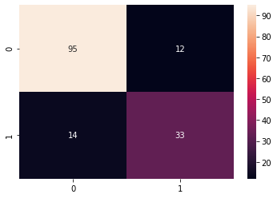

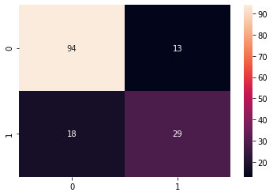
Heat plots of the models
Kneighbour Classifier
Simple Vector machine Classifier
Gaussian Naive Bayes classifier

Slide 12
Conclusion
The main aim of this project was to design and implement Diabetes Prediction Using Machine Learning Methods and Performance Analysis of that methods and it has been achieved successfully
Here on from using the three models we observe that KNeighbor classifier have high accuracy.
The Experimental results can be assist health care to predict and make early decision to cure diabetes and save humans life.

Slide 13


